Slide 1
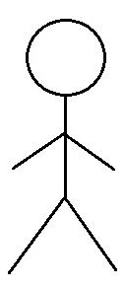
Use Case Diagram
Health App
Use Case Diagram
Module: 04. Coach Connect
Customer Onboarding Manager
04.01 List Coaches
Customers (Fitness Enthusiast)
04.02 Subscribe Coach
Customer Support Manager
04.03 Schedule Appointment
Dietitians
4.04 Access Routine
Accounts Manager
Fitness Trainer
Color Code
Finance Manager
Implemented in Iteration 03

Slide 2
Use Case Diagram
Health App
Use Case Diagram
Module: 05 Dashboard
05.01 Display Fitness Activity
Customers (Fitness Enthusiast)
5.02 Display Diet Analysis
Customer Support Manager
Dietitians
05.03 List User Goals
Fitness Trainer
Color Code
Implemented in Iteration 04

